Slide 1
Molecule

Slide 2
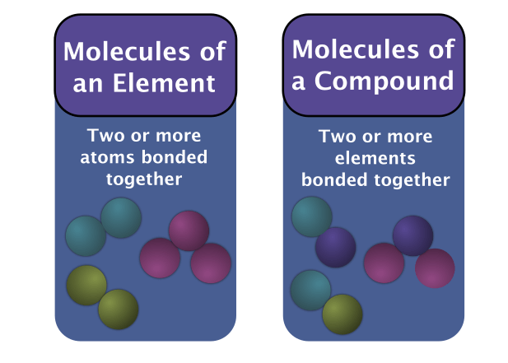
1. | Define the term molecule.
2. | Compare and contrast molecules and compounds.
3. | Distinguish between molecules of elements and molecules of compounds.

Slide 3
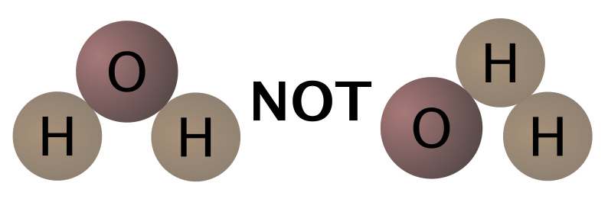
Molecules make up the structure of many gaseous and liquid compounds, whilst many solids have different structures which do not form molecules (more on this later).
For example, to make a water molecule, you need: one oxygen atom and two hydrogen atoms. These atoms must also be in the correct order. Both hydrogen atoms should be bonded to the oxygen atom, never to each other.

Slide 4
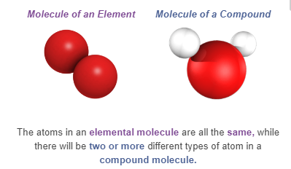
There are actually two types of molecules: molecules of an element and molecules of a compound.

Slide 5
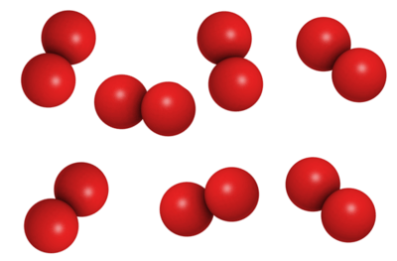
Molecules can be made of atoms of the same element chemically bonded together.
These are the molecules of an element. For example: oxygen gas exists as pairs of chemically bonded oxygen atoms. These are oxygen molecules.

Slide 6
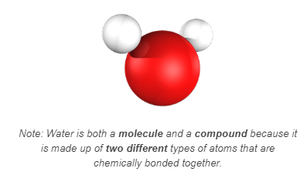
A molecule of water contains two different types of atoms, so this is a molecule of a compound.

Slide 7
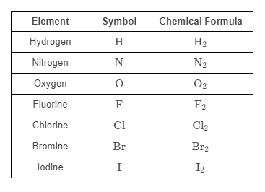
The diatomic elements are 7 elements from the periodic table that never want to be alone.
Instead, their atoms bond in pairs, forming diatomic molecules. These are a type of elemental molecule because they are made up of one type of atom.
Diatomic means "two atoms."

Slide 8
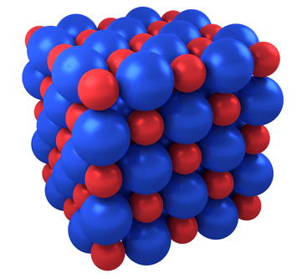
Many solid compounds and elements do not form molecules; instead, they form crystals.
Crystals are atomic structures called lattices. Atoms are bound very strongly to each other within a lattice, and so the substances which form a lattice tend to form very hard solids.

Slide 9
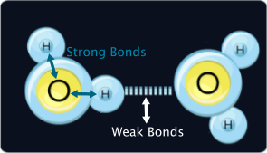
A lattice structure is different from a molecule.
Molecules are individual units with two different types of chemical bond.
Molecular substances have strong bonds which connect the atoms inside the molecule, and weaker bonds which connect the molecules.

Slide 10
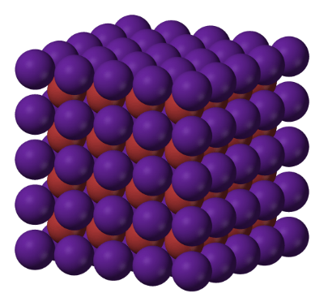
There is only one type of bond inside a lattice, meaning that a lattice structure cannot be separated into individual molecules.
A separated lattice will just become atoms.

Slide 11
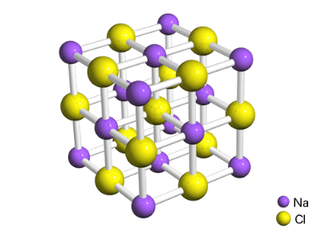
A salt crystal is made up of a lattice of sodium atoms and chlorine atoms.
The chemical formula for salt, NaCl, says that salt is made up of sodium and chlorine.
This is not the formula for a molecule (a molecular formula). Instead, it is telling us that for every sodium atom, there is one chlorine atom. We can see this in the lattice below:

Slide 12
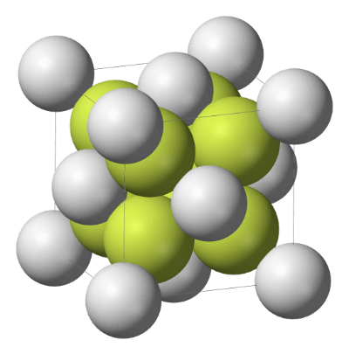
The chemical formula of a lattice solid tells us the ratio of atoms in the lattice.
Beach sand is made up of silicon and oxygen, with the formula SiO2​.
This means that a sand crystal will contain two oxygen atoms to every silicon atom. The ratio is 1:2 (Silicon:Oxygen).

Slide 13

You can also have elemental lattices.
These occur in elemental solids, such as iron or copper metal.
So a big iron sword like the one below will be made up of pure iron. The iron, instead of forming molecules or single atoms, forms a lattice structure of iron.

